Slide 1
Chapter 2: What’s the story we’re going to build?
Learning Bluemix & Blockchain
Bob Dill, IBM Distinguished Engineer, CTO Global Technical Sales
David Smits, Senior Certified Architect, IBM Blockchain

Slide 2
The Plan: 30 minute Chapters with an hour or two of practice
Chapter 1: What is Blockchain? Concept and Architecture overview
Chapter 2: What's the story we’re going to build
Chapter 2.1: Architecture for the Story
Chapter 3: Set up local HyperLedger V1 development environment
Chapter 4: Build and test the network
Chapter 5: Administration User Experience
Chapter 6: Buyer Support and User Experience
Chapter 7: Seller Support and User Experience
Chapter 8: Shipper Support and User Experience
Chapter 9: Provider Support and User Experience
Chapter 10: Finance Company Support and User Experience
Chapter 11: Combining for Demonstration
Chapter 12: Events and Automating for Demonstration

Slide 3
Dispute Resolution for a Finance Organization
Dispute resolution requires gathering and correlating facts from multiple parties. This is a slow and labor intensive effort, which ties up over $100M at any point in time.
In this example, those parties are:
The Finance Organization
The Buyer
The Seller
The Provider
The Shipper
Request Product
Request Payment
Debit Account
Request drop ship from Provider
Request Shipment
Deliver product
Financer
3
2
Buyer
1
Seller
6
4
Shipper
5
Provider

Slide 4
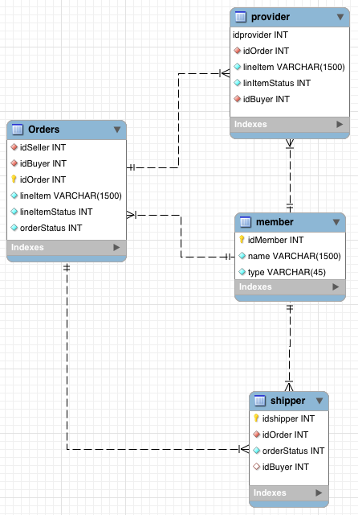
Data Model
An order has a status of:
Ordered
toProvider
toShipper
Shipping
Delivered
Paid
inDispute
An item has a status of:
Ordered
toProvider
toShipper
Shipping
Delivered
Backordered

Slide 5
The basic stories
As a Finance Organization, I want to see the finance related status of every order executed by my clients when they are using my credit services instantly and in real-time
This will allow me to manage dispute resolution over the phone immediately rather than taking multiple weeks to resolve a dispute.
As a seller, I want to see the order, shipping and finance status of every sale in the system.
As a buyer, I want to see the real-time status of every order.
As a buyer, I want to be able to initiate a dispute with the click of a single button and provide all required data automatically to my finance organization
As a manufacturer, I want to be able to see all open orders and the shipment status on all orders.
As a shipper, I want to be able to interact with this system with as little change as possible on my end.

Slide 6
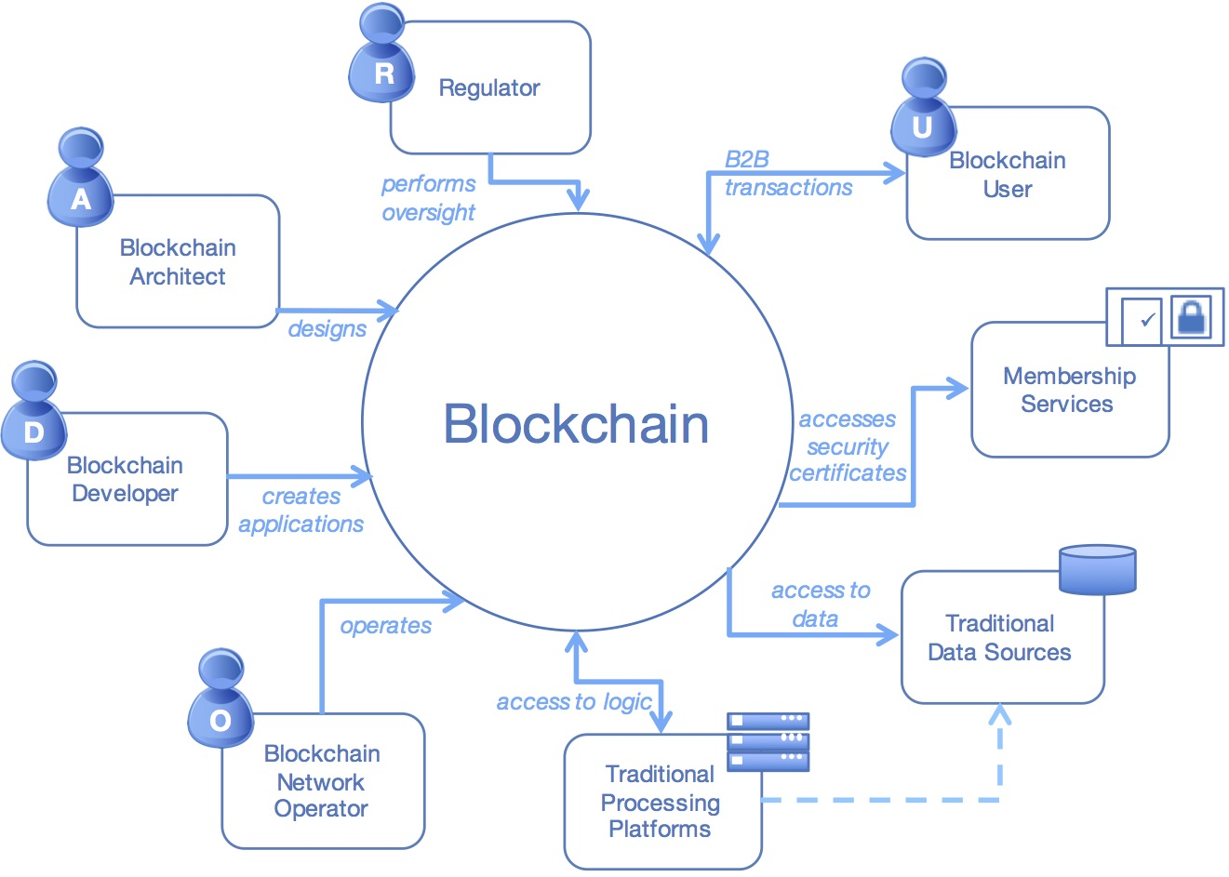
Actors in a blockchain solution
Notes:
This shows the major actors within a blockchain network and what they are doing within the blockchain. The details are on the next slide.
Presenters might like to hide either this slide or the following one, depending on personal preference.

Slide 7


Actors in a blockchain solution
Blockchain
Architect
Responsible for the architecture and design of the blockchain solution
Chapter 1 & 2.1
A
Blockchain
User
The business user, operating in a business network. This role interacts with the Blockchain using an application. They are not aware of the Blockchain.
Financing Co, Buyer, Seller, Shipper, Provider
U
Blockchain
Regulator
The overall authority in a business network. Specifically, regulators may require broad access to the ledger’s contents.
Finance Co.
R
Blockchain
Developer
The developer of applications and smart contracts that interact with the Blockchain and are used by Blockchain users.
Chapters 3-12
D
Manages and monitors the Blockchain network. Each business in the network has a Blockchain Network operator.
Chapters 4 & 5
Blockchain
Operator
O
Chapters 4 & 5
Membership
Services
Manages the different types of certificates required to run a permissioned Blockchain.
Traditional Processing Platform
Outside the Tutorial
An existing computer system which may be used by the Blockchain to augment processing. This system may also need to initiate requests into the Blockchain.
Supplied in Tutorial
Traditional Data Sources
An existing data system which may provide data to influence the behavior of smart contracts.
Notes:
A description of the major actors within the blockchain. The details are on the next slide.
Presenters might like to hide either this slide or the preceding one, depending on personal preference.

Slide 8
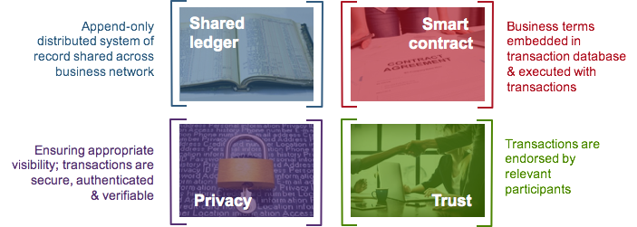
Blockchain in a Nutshell
Broader participation, lower cost, increased efficiency

Slide 9
Industrial Blockchain – IBM’s Perspective
Private & Permissioned (not public) | Appropriate Consensus
Private = known set of participants in a business network, known identity Permissioned = members need to fulfill criteria to join (Public = open set of participants, anonymitiy) | Mechanism by which participants agree on state of shared ledger. Public needs heavyweight consensus for anonymous participants Known participants opens up other forms (e.g. participant bonds)
Privacy through Cryptography | Compliance & Audit
Transaction privacy Participant identity & trading privacy | Current spend can be vastly reduced Automated processes possible

Slide 10
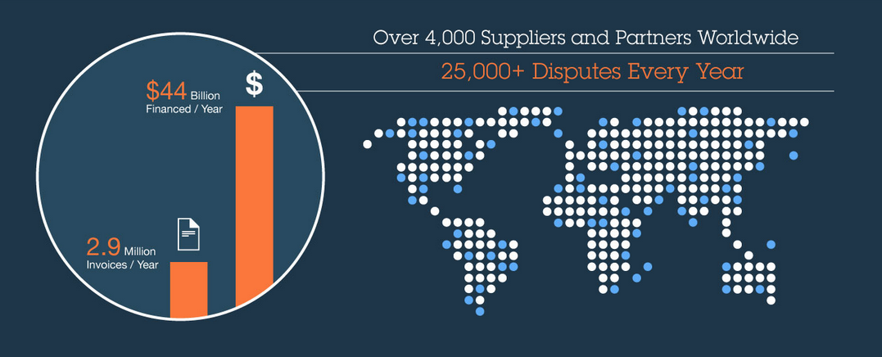
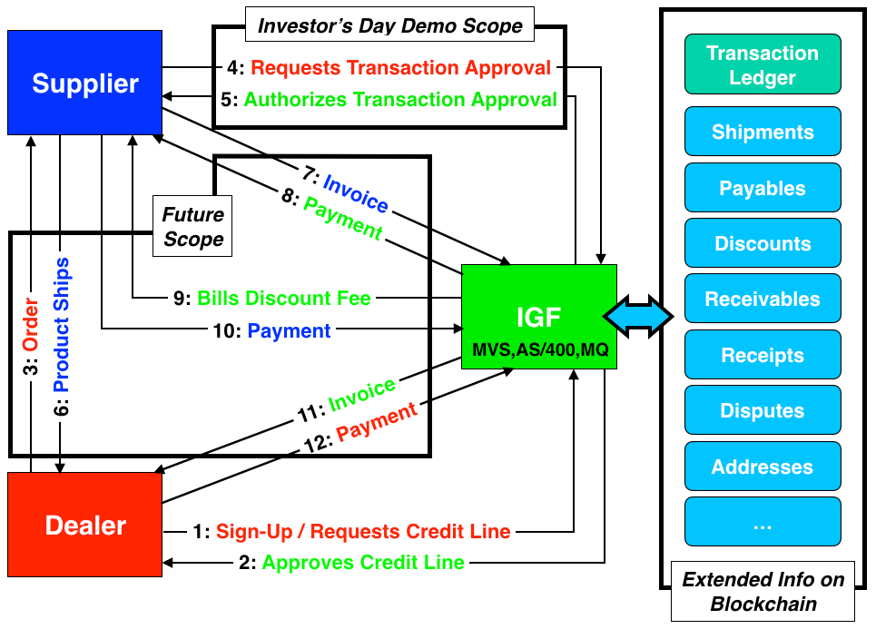
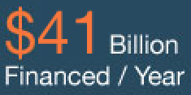
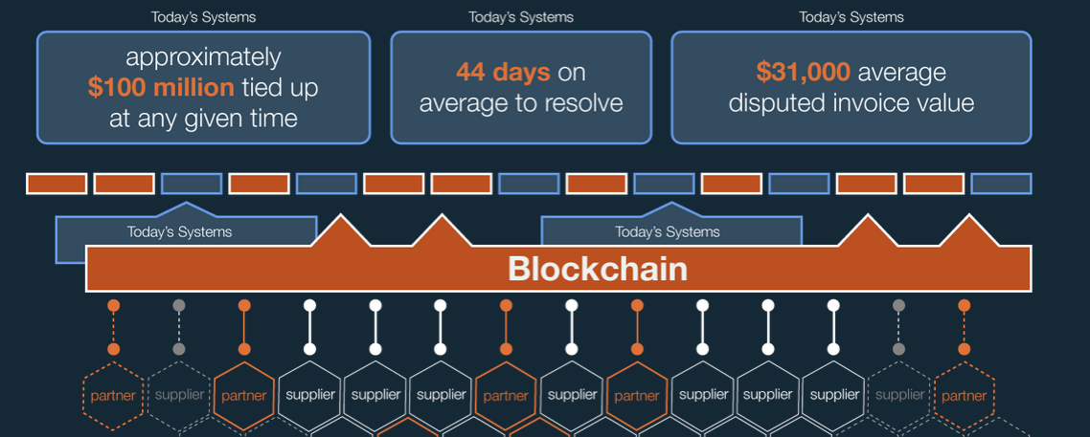
Blockchain for IBM Global Financing
Immutability / Non-repudiability of blockchain ledger Comprehensive view of all operational data
Less disputes, faster settlement Free flow of capital between parties
Distributed & Replicated Less Outages, Highly extensible

Slide 11
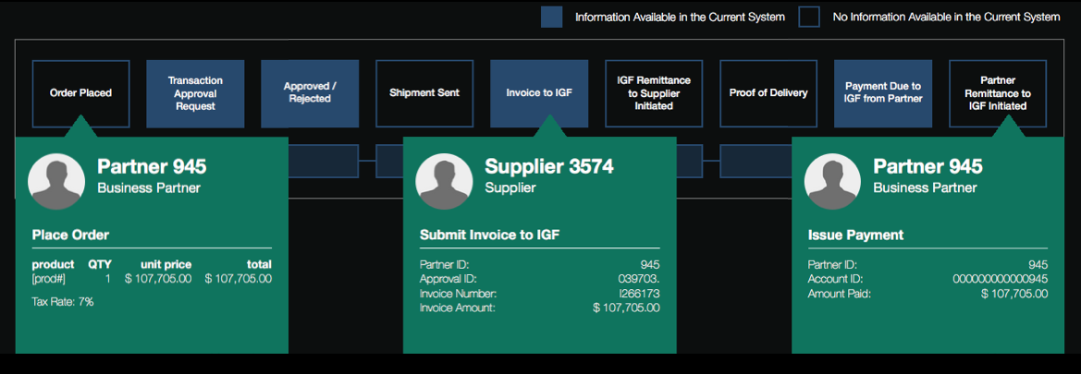
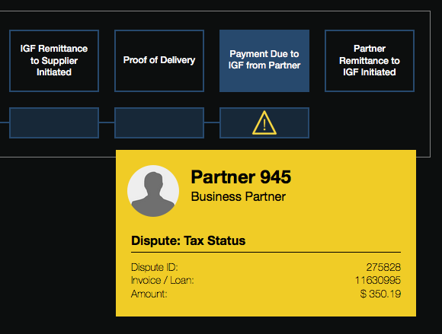
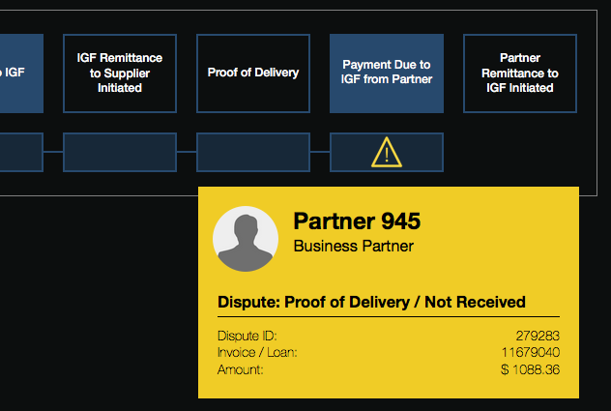
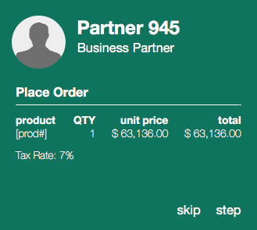
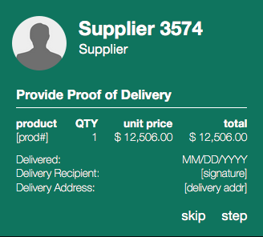
Blockchain for IBM Global Financing
An immutable, non-repudiable record of events, shared between Partners, Suppliers and IGF…
…enabling a comprehensive view across the entire transaction lifecycle….
…with enhanced visibility to prevent or speed the resolution of disputes...
Demo Video:
https://youtu.be/F0P7NM7d-ps

Slide 12
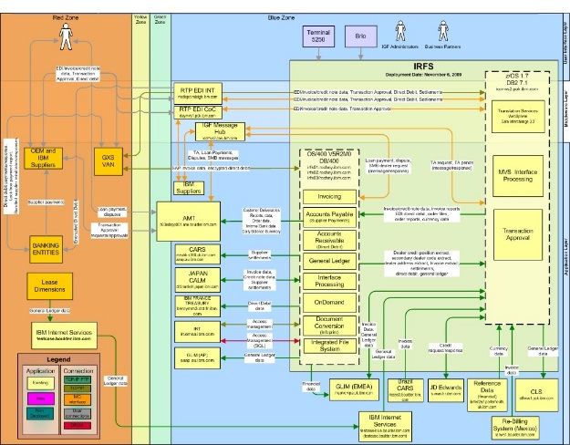
Blockchain for IBM Global Financing
Transaction Approvals
External
Data
Existing
IBM Global Financing
Systems
UI
Invoices
Validating Peer
Application
Remittances
Application
Validating Peer
Validating Peer
Application REST APIs
TA Data Services
Invoice Data Services
Remittance Data Services
External Data Services
Application
Validating Peer
Application
Indexing

Slide 13
Blockchain Data for Dispute Resolution
Data recorded in the Blockchain can improve resolution time for common disputes
Dispute Reason | Data Recorded in Blockchain
 | PO | Shipment | Proof of Delivery | Invoice
Shortshipped Order by Part Quantity or by Box | Line item and quantity info | Shipment line items and quantities
Proof of Delivery |  |  | Proof of Delivery

Slide 14
Benefits & Next Steps
Potential Benefits
Reduction in Disputes and Dispute Resolution Cycle Time (initial estimates of 10%), leading to:
better customer satisfaction
differentiation from your competitors
reduced costs associated with dispute resolution
What Can I Do to Get Ready?
Prepare for Availability of Data to be shared on the Blockchain:
order information
shipping information
receipt of shipment
additional information that would benefit your partners

Slide 15
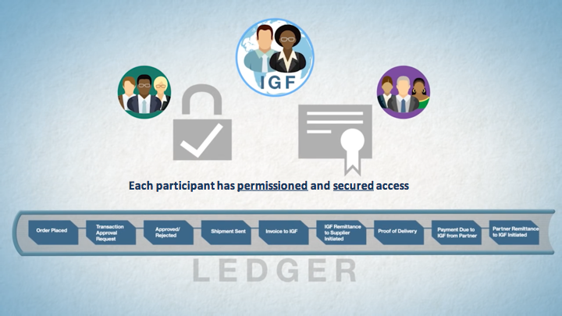



Seller
Provider
Buyer
Shipper

Slide 16
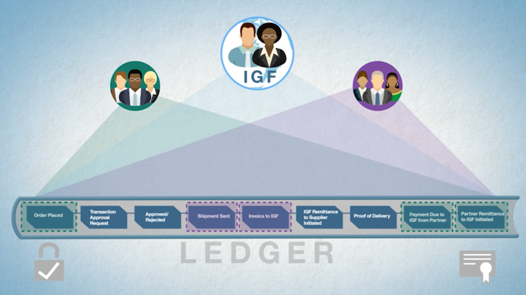
Seller
Provider
Buyer
Shipper
￼

Slide 17
The Plan: 30 minute Chapters with an hour or two of practice
Chapter 1: What is Blockchain? Concept and Architecture overview
Chapter 2: What's the story we’re going to build
Chapter 2.1: Architecture for the Story
Chapter 3: Set up local HyperLedger V1 development environment
Chapter 4: Build and test the network
Chapter 5: Administration User Experience
Chapter 6: Buyer Support and User Experience
Chapter 7: Seller Support and User Experience
Chapter 8: Shipper Support and User Experience
Chapter 9: Provider Support and User Experience
Chapter 10: Finance Company Support and User Experience
Chapter 11: Combining for Demonstration
Chapter 12: Events and Automating for Demonstration

Slide 18
Chapter 3: Set up local HyperLedger V1 development environment
Learning Bluemix & Blockchain
Bob Dill, IBM Distinguished Engineer, CTO Global Technical Sales
David Smits, Senior Certified Architect, IBM Blockchain

